Slide 1

E6893 Big Data Analytics
Arbitrary Aspect Identification, Extraction, and Ranking
Project ID: 201912-36 Team Members (with UNI): Cedric Jouan (cj2567) and Austin Bell (alb2307)

Slide 2
Intro and Goal
Goal: Identify, extract, and rank the importance of product aspects for each category on Amazon
Aspect refers to a component or attribute of a specific product (e.g., an aspect of a phone may be its battery life)
Leveraging the unstructured text in Amazon Product reviews, we can identify aspects for different categories and measure consumer sentiment towards each aspect.
Analytical Pipeline
Aspect identification
Group Aspects by Category
Assign single name to each aspect
Measure consumer sentiment of each aspect
Assign value to each aspect by category
Rank Aspects
Visualize

Slide 3

Example: Aspect Identification
Review of Iphone 11
Potential aspects:
Screen
Design
Camera
Charger
2.5mm port
Ipods

Slide 4
Proposed Value
Our analysis looks to better understand reasons for consumer purchases
Which aspects contribute most to positive opinions towards specific products?
Which aspects correlate most with likelihood of purchase within a particular product category?
Through leveraging open text product reviews, we seek to:
Reduce potential bias of respondents found in survey analysis
Reduce cost and time compared to controlled experiments
While simultaneously developing a framework that is highly scalable and replicable

Slide 5
Dataset
Amazon Product Reviews
Product reviews from May 1996 - July 2014
Includes: review text, rating, and product ID
142.8 million observations
24 broad product categories with many more subcategories
Metadata
Includes: product ID, category, and price
9.4 million products
Links to review data via product ID
R. He, J. McAuley. Modeling the visual evolution of fashion trends with one-class collaborative filtering. WWW, 2016
J. McAuley, C. Targett, J. Shi, A. van den Hengel. Image-based recommendations on styles and substitutes. SIGIR, 2015

Slide 6
Methods
Four discrete tasks:
Extract aspects
Group and assign names to aspects
Compute sentiment of each aspect
Assign value and rank aspects

Slide 7
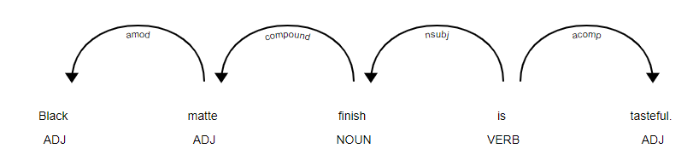
Extract Aspects
Dependency Parsing
Product aspects are discussed in linguistically similar ways
Defining linguistic rules and traversing dependency trees allows us to extract aspects independent of text content
Liu B., “Sentiment Analysis and Subjectivity”., Handbook of Natural Language Processing, 2010

Slide 8


Extract Aspects - Results
Result of the Aspect Extraction
Raw Review:
Extracted Text:
Unique Aspects:
Future consideration: split noun chunks and descriptors into different aspect groups

Slide 9
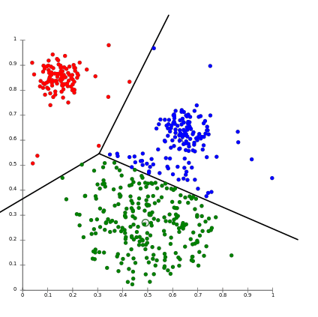
Group and Assign Names to Aspects
Clustering
Convert extracted aspects to word vectors
Leverage clustering algorithms to group semantically similar aspects
Extract word(s) most representative of each group
Assign extracted word(s) as common name for each aspect

Slide 10
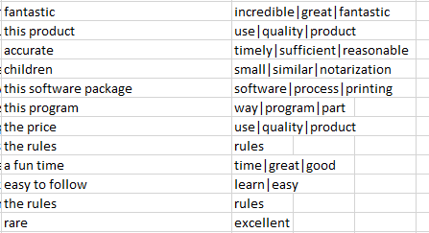
Group and Assign Names to Aspects - Results
Initial clustering algorithm implemented:
Assign names to aspects by main category (e.g., “Electronics”, “Toys & Games”, or “Sports”)
Glove 100 Dimension Embeddings
K Means random initialization, euclidean distance
TF-IDF weighting to select most representative words
Extracted Aspect Clustered Result
Future consideration: identify and exclude intra-cluster outliers

Slide 11
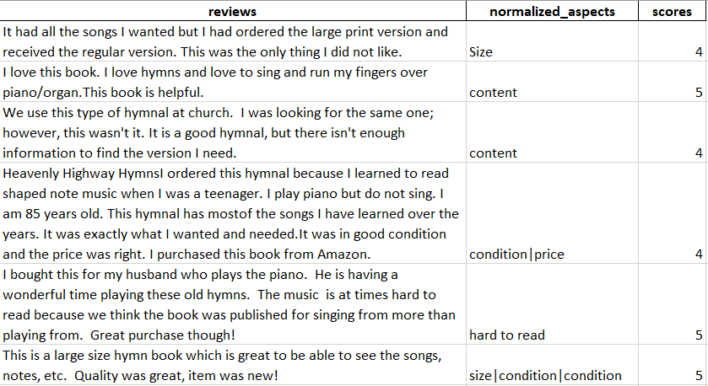

Compute Sentiment of each Aspect
Data Structure :
Sentiment analysis :
Split the dataset,
Create one training set and one test set for each aspect,
Train a Deep learning sentiment analyzer for each aspect,
Evaluate sentiment analyzers.

Slide 12



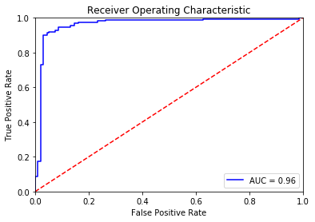
Compute Sentiment of each Aspect - Results
Model selection and Training
CNN_BiLSTM Tensorflow
Takes advantage to the large number of sample.
Good performance.
Prediction is slow.
Difficult to integrate in the pipeline.
Training Data :
Texts = 500 000 unused reviews from the original dataset.
Labels = 0 if the review’s score is 1 or 2, and 1 if the review’s score is 4 or 5.
Glove 100 Embedding
Convolution_1D(128)
Bidirectional_LSTM(100)
Dropout(0,2)
Dense(1)
Integration in the pipeline
Split the reviews to isolate each aspect.
Prediction.
For each simple sentence that discuss an aspect we predict the sentiment.
Then we aggregate the sentiments in one “opinion vector” per review. E.g or = [ 0, 0, +0.9, 0, 0, -0.4]

Slide 13

Assign Value and Rank Aspects
The objective is to compute the importance weights of each aspect from the opinion vectors and the overall score of the review.
The weights should represent the influence of the aspect on the overall score.
Inputs
Model
Outputs
We want the weight vector w such that
Coefficients :
The coefficients are the weights that represent the importance of each aspects.
Statistics :
We are also interested by the standard deviation of the coefficients.
X=
Opinion vectors
or
; y=
scores
Or
Therefore we fit a linear regression between X and y
The features are the sentiment score for each aspect.
The target is the score review.
This model is applied at a sub category level. Therefore we output one set of weights per sub category.
Remark : We are still developing a more robust model for the ranking.

Slide 14
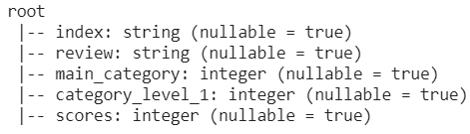
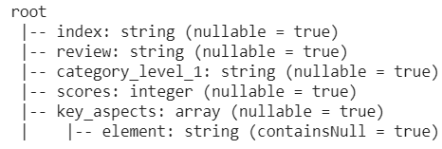
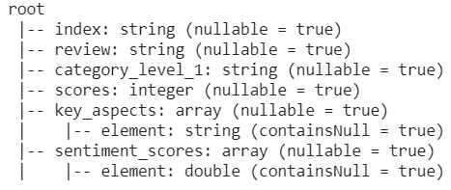
Overview and Output description
Input dataset
Aspects dataset
Sentiments dataset
Ranks dataset
Level : Full Data
Level : Global Category
Level : Global Category
Level : Category level 1
W → Coefficients of the regression
S → standard deviation of the coefficients
F → Aspects Frequencies
1- 142.8 million observations
24 broad product categories with many more subcategories
Create set of key Aspects for every global category
Identify aspects discussed in each reviews
Compute sentiments for each aspects.
Create Opinion Vectors
Outputs :
One list of aspect per main Category
The frequencies of these aspects in each sub categories (level 1 category)
The importance weights of these aspects in each sub categories
The standard deviation of these weights in each sub categories

Slide 15
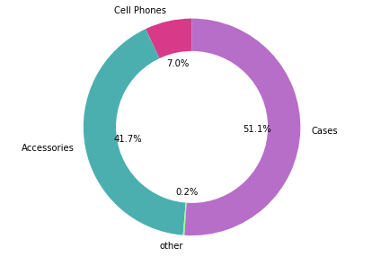
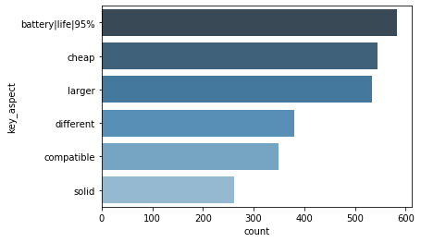
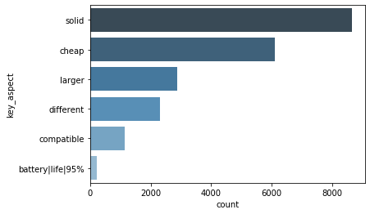
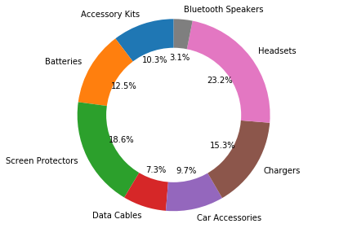
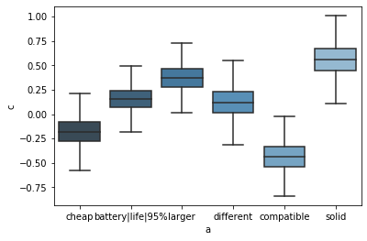
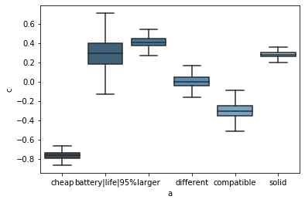
In-depth Analysis of “Cell Phones & Accessories”
Sub Category : Batteries
Sub Category : Cases
Aspects frequencies in the Case category
Coefficients of the logistic regression
Insights :
Coefficients of the logistic regression
Compatibility: Most negative aspect of Cell Phones
Batterie life time: well discussed in Cell phones but seems not very important. Might be surprising.
Much less discussed in Cases category but is still important !
Price : Much more sensitive for Cases.

Slide 16
Conclusion
Through chaining modern day NLP solutions, we developed a framework that provides substantial insight into consumer’s purchasing reasons
Our framework was developed such that it is independent of the data source and can be applied to any source of open text reviews in a completely unsupervised manner
Intended future work is to understand causal reasons for purchases rather than purely associative

